Slide 1
11 References & the Copy-Constructor
Dandan Song
Beijing Institute of Technology

Slide 2
11.1 Pointers in C++
C++ is a more strongly typed language.
C++ doesn’t let you casually assign a pointer of one type to another.
If you really want to treat one type as another, you must make it explicit using a cast.

Slide 3
11.2 References in C++
A reference (&) is usually used for function argument lists and function return values. But you can also make a free-standing reference.
A reference must be initialized when it is created. (different from Pointers)
Once a reference is initialized to an object, it cannot be changed to refer to another object. (Pointers can be pointed to another object.)
You cannot have NULL references. You must always be able to assume that a reference is connected to a legitimate piece of storage.

Slide 4
int a=3,b=5;
int& m=a; //ok
int& m; //error
int& m=b; //error
int& k=m;
int n=m;
int* p=&m;
int*& ref=p;
m=m+5;
a
m
8
,k
3
n
3
ref,
p

Slide 5
References in functions
When a reference is used as a function argument, any modification to the reference inside the function will cause changes to the argument outside the function.
If you return a reference from a function, you must take the same care as if you return a pointer from a function avoiding to refer to unknown memory.

Slide 6
References in functions
//: C11:Reference.cpp
// Simple C++ references
int* f(int* p)
{
(*p)++;
return p; // Safe, p is outside this scope
}
int& g(int& x)
{
x++; // Same effect as in f()
return x; // Safe, outside this scope
}

Slide 7
int& h()
{
int q=0;
//! return q; // Error
static int x=1;
return x; // Safe, x lives outside this scope
}
void main()
{
int a = 0;
f(&a); // Ugly (but explicit)
g(a); // Clean (but hidden)
} ///:~

Slide 8
const references
Making the argument a const reference will allow the function to be used in all situations.
void f(int& i) {i++;}
void g(const int& j) {cout<<j; }
void main()
{
int a=1;
//f(1); // Error, int& i=1;
f(a); // ok, int& i=a; i++
g(1); // ok, 1
g(a); // ok, 2
} ///:~

Slide 9
Pointer references
//: C11:ReferenceToPointer.cpp
#include <iostream>
using namespace std;
void increment(int*& i) { i++; }
void main()
{
int a = 2;
int* p = &a;
cout << "p = " << p << ": "<< *p <<endl;
increment(p);
cout << "p = " << p << ": "<< *p << endl;
} ///:~
When you want to modify the contents of the pointer rather than what it points to, the references syntax is cleaner.

Slide 10
11.3 The copy-constructor
int i(5);
int j=i; //initialization by copy
Date today(2002,10,10);
Date tomorrow=today; //initialization by copy
The aim: a creating class object can be initialized with a copy of another created object of the same class.
If a user has declared a copy constructor, it will be used. If not, the compiler will try to generate a public one.
The default semantics is memberwise copy.
Format: X::X(const X&)

Slide 11
#include <iostream>
using namespace std;
class Date
{
int year, month, day;
public:
Date(int y=0, int m=0, int d=0)
{ year=y; month=m; day=d;
cout<<"Constructor called."<<endl; }
Date(const Date & r)
{
year=r.year; month=r.month; day=r.day;
cout<<“Copy constructor called."<<endl;
}
~Date( ) { cout<<"Destructor called."<<endl; }
};
void main() {
Date d1(2003,9,20);
Date d2=d1;
}

Slide 12
Constructor called.
Copy constructor called.
Destructor called.
Destructor called.

Slide 13
When Copy Constructors ?
A creating class object is initialized by another created object of the same class.
The Copy Constructor is called when passing arguments by values.
The Copy Constructor is called when a function returning an object value.
The Copy Constructor is not called when passing arguments by references. Because no new object is created.

Slide 14
// tpoint.h
class TPoint {
public:
TPoint(int x,int y)
{X=x;Y=y; cout<<"Constructor called."<<X<<endl;}
TPoint(const TPoint& p); //copy constructor
~TPoint() {cout<<"Destructor called."<<X<<endl;}
int Xcoord() {return X;}
int Ycoord() {return Y;}
private:
int X,Y;
};
TPoint::TPoint(const TPoint& p) {
X=p.X;
Y=p.Y;
cout<<"Copy Constructor called."<<X<<endl;
}

Slide 15
// tpoint.cpp
#include <iostream>
using namespace std;
#include "tpoint.h"
TPoint f(TPoint Q) // Pass by data value
{ cout<<"OK! "<<endl;
int x, y;
x=Q.Xcoord()+10;
y=Q.Ycoord()+20;
TPoint R(x,y);
return R; // Return R’s data value
}
void main()
{ TPoint M(20,35),P(0,0);
TPoint N(M); //M is a created object, N is a creating object
P=f(N);
cout<<"P="<<P.Xcoord()<<", "<<P.Ycoord()<<endl;
}

Slide 16
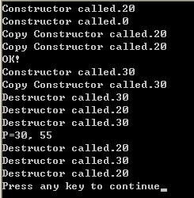

Slide 17
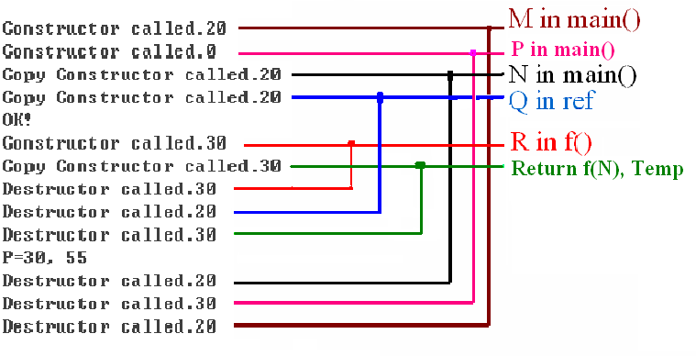

Slide 18
11.4 Pointers to members
Pointers to data members
Pointers to member functions

Slide 19
Pointers to data members
//: C11:PointerToMemberData.cpp
#include <iostream>
using namespace std;
class Data
{
public:
int a, b, c;
void print() const
{
cout <<a << "," << b<<","
<< c << endl;
}
};
void main( )
{
Data d;
Data* dp = &d;
int Data::*pmInt = &Data::a;
dp->*pmInt = 47;
pmInt = &Data::b;
d.*pmInt = 48;
pmInt = &Data::c;
dp->*pmInt = 49;
dp->print();
} ///:~
47, 48, 49

Slide 20
Pointers to member functions
//: C11:PointerToMemberFunction.cpp
#include <iostream>
using namespace std;
class Widget {
public:
void f(int) const { cout << "Widget::f()\n"; }
void h(int) const { cout << "Widget::h()\n"; }
};
void main( ) {
Widget w;
Widget* wp = &w;
void (Widget::*pmem)(int) const = &Widget::h;
(w.*pmem)(1);
(wp->*pmem)(2);
} ///:~
int (*fp)(float);
Widget::h()
Widget::h()

Slide 21
Summary
Reference
Copy-constructor
Pointer to members
  to data members
  to member functions

Slide 22
Exercises
P505: 8, 9, 17

